Slide 1
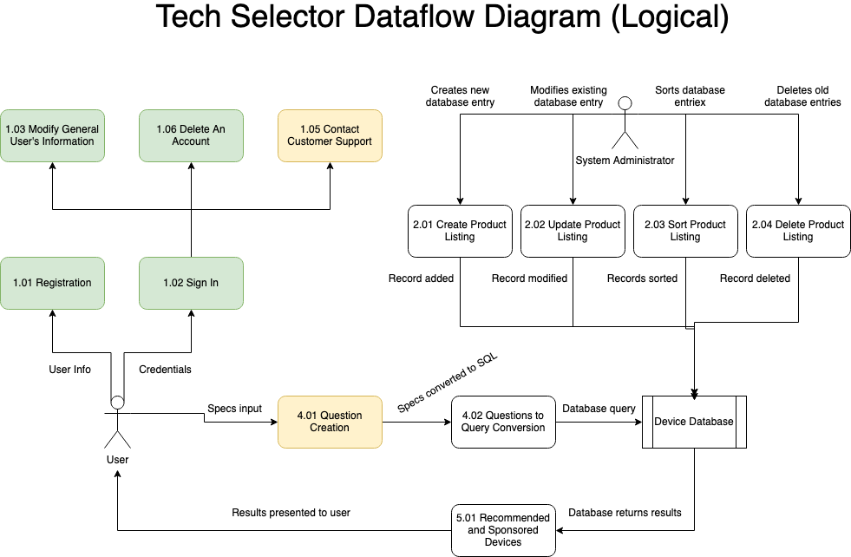

Slide 2
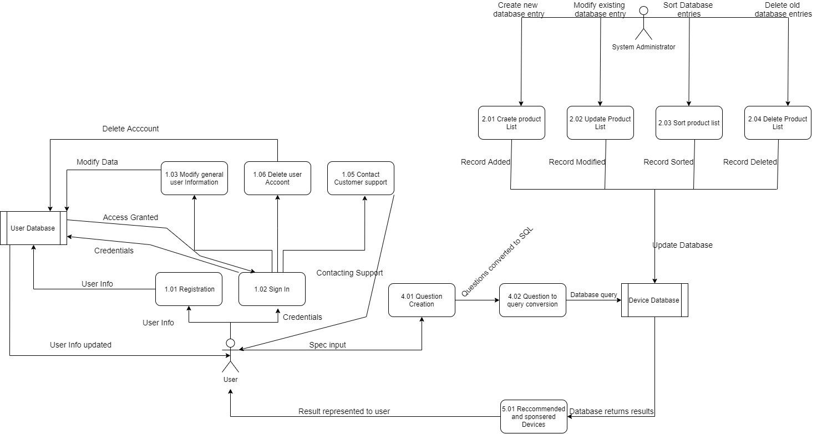
Tech Selector Dataflow Diagram (Physical)

